Slide 1
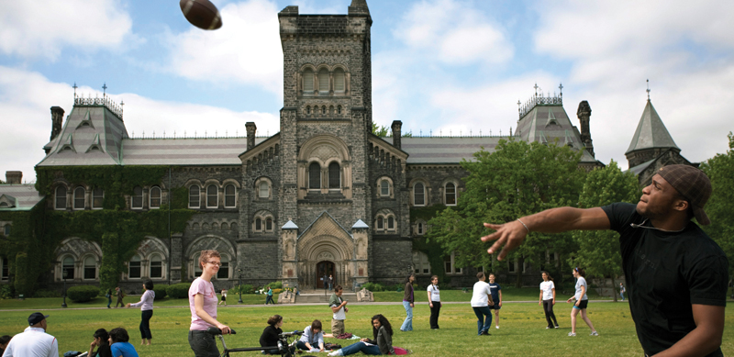

Recognition Update
Spring, 2018

Slide 2
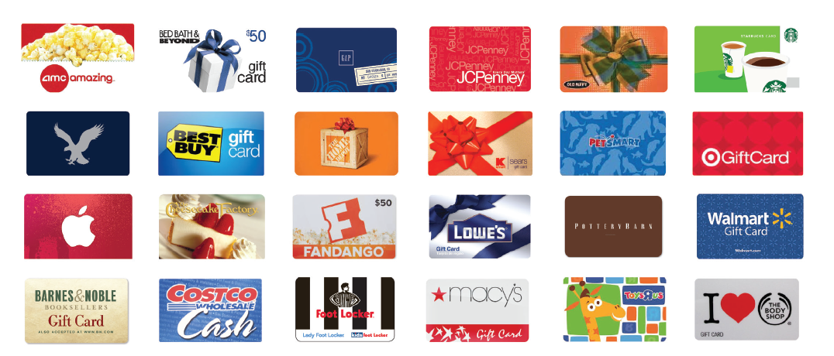
Free Gift card?

Slide 3
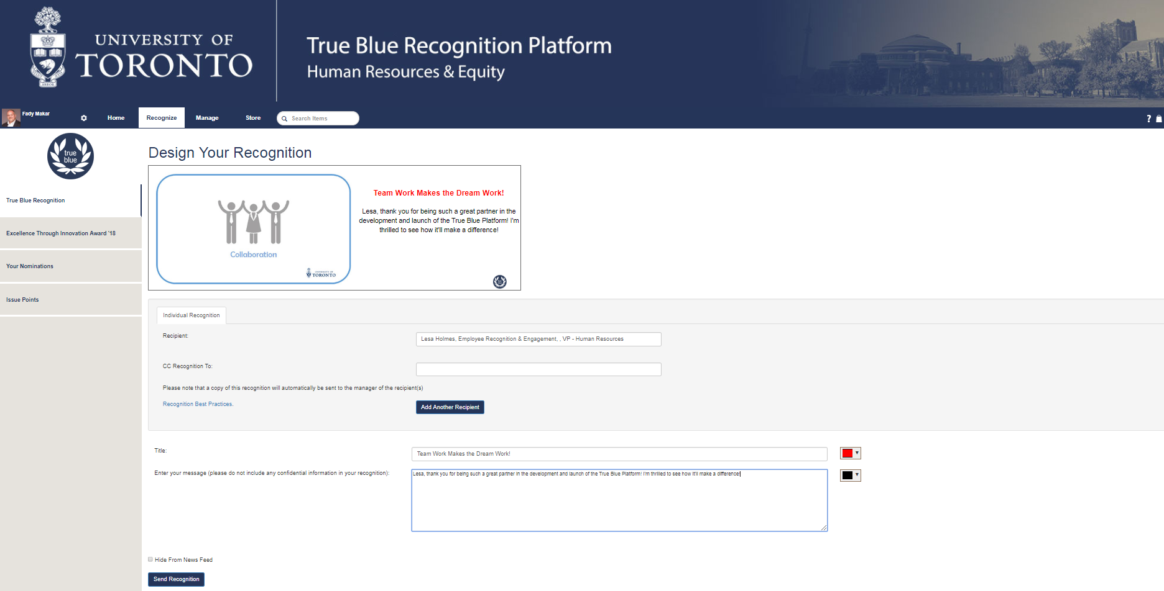
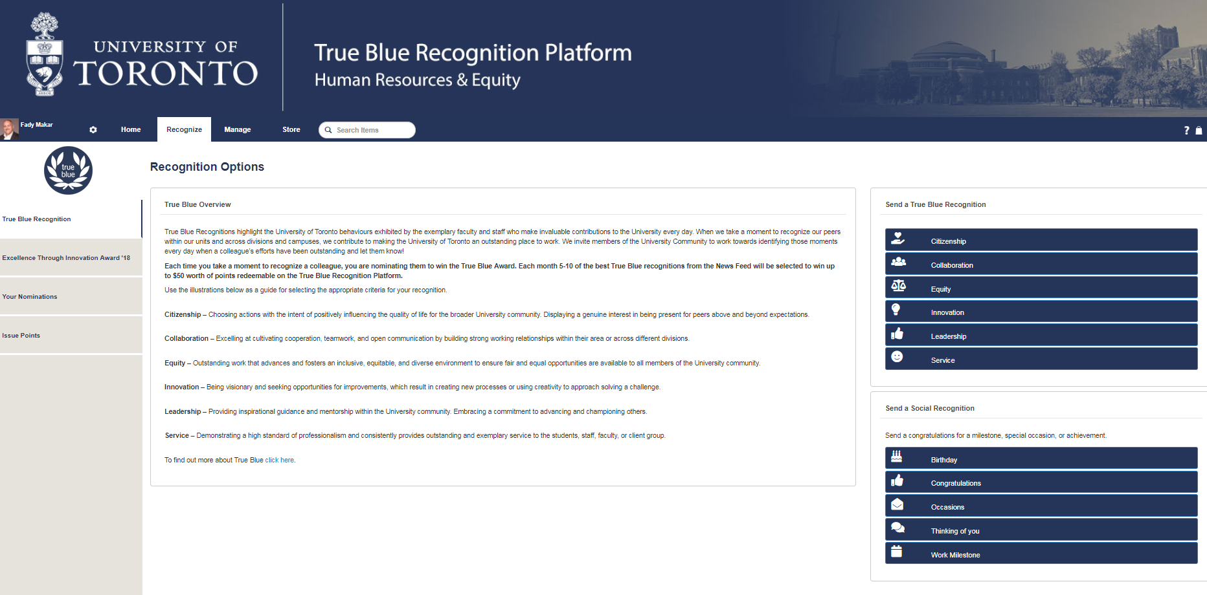
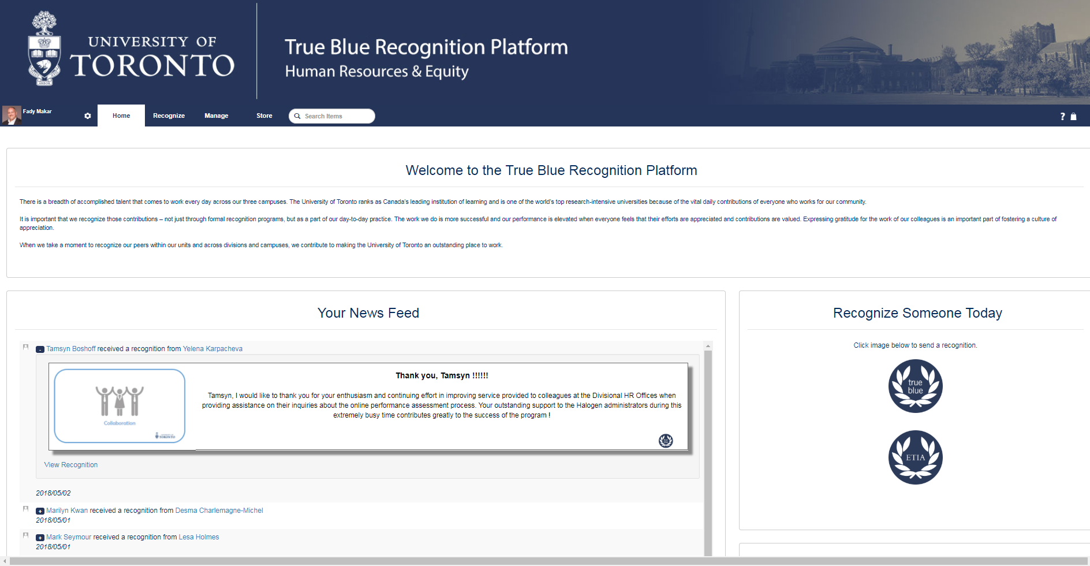
UofT.me/Thanks
ChooseWhy?
Click here!
Finished
Click here!

Slide 4
Mandate/ Priorities
Consult/ Build Engagement Strategy
Launch Recognition Tool
Build “Speaking Up” survey plan

Slide 5
Why Recognition & Engagement
Maintain Employee satisfaction
Achieve Employee Engagement
Strive towards Exceptional Employee Experiences

Slide 6
Themes & Trends
Highlights captured from research on High Ed. Institutions and discussions with internal stakeholders (DHROs, CAO, Managers)
Key Insights:
Our people are engaged (but as with any large institution there are pockets of opportunity)
Service awards require a review - most institutions start at 10 years
Leverage technology to encourage more consistent informal recognition
Managers are convinced of the power recognition, but need training and tools
*Based on online research of Times Higher Education Top 10 Research universities + UBC, Calgary, Michigan, Penn state.

Slide 7
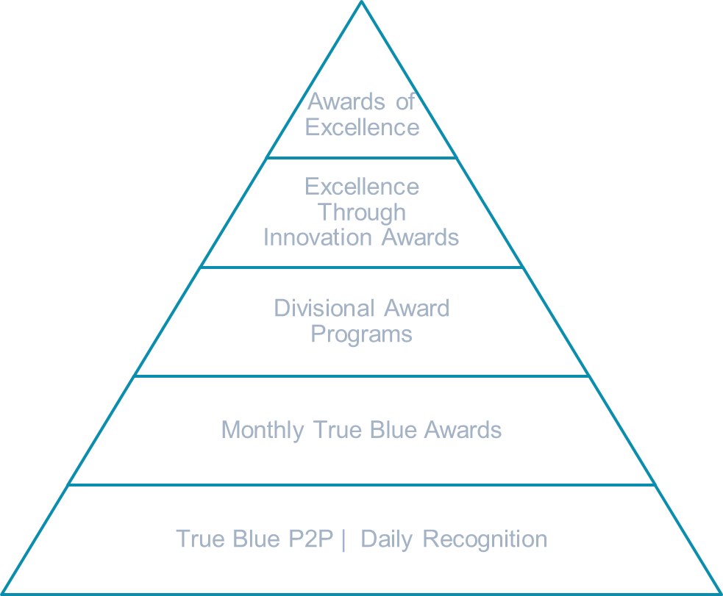
Proposed Recognition Infrastructure
Building blocks for a culture of appreciation
Celebrating significant accomplishments – top 10%
Pipelining
Recognizing small victories – 25-75% of our population

Slide 8
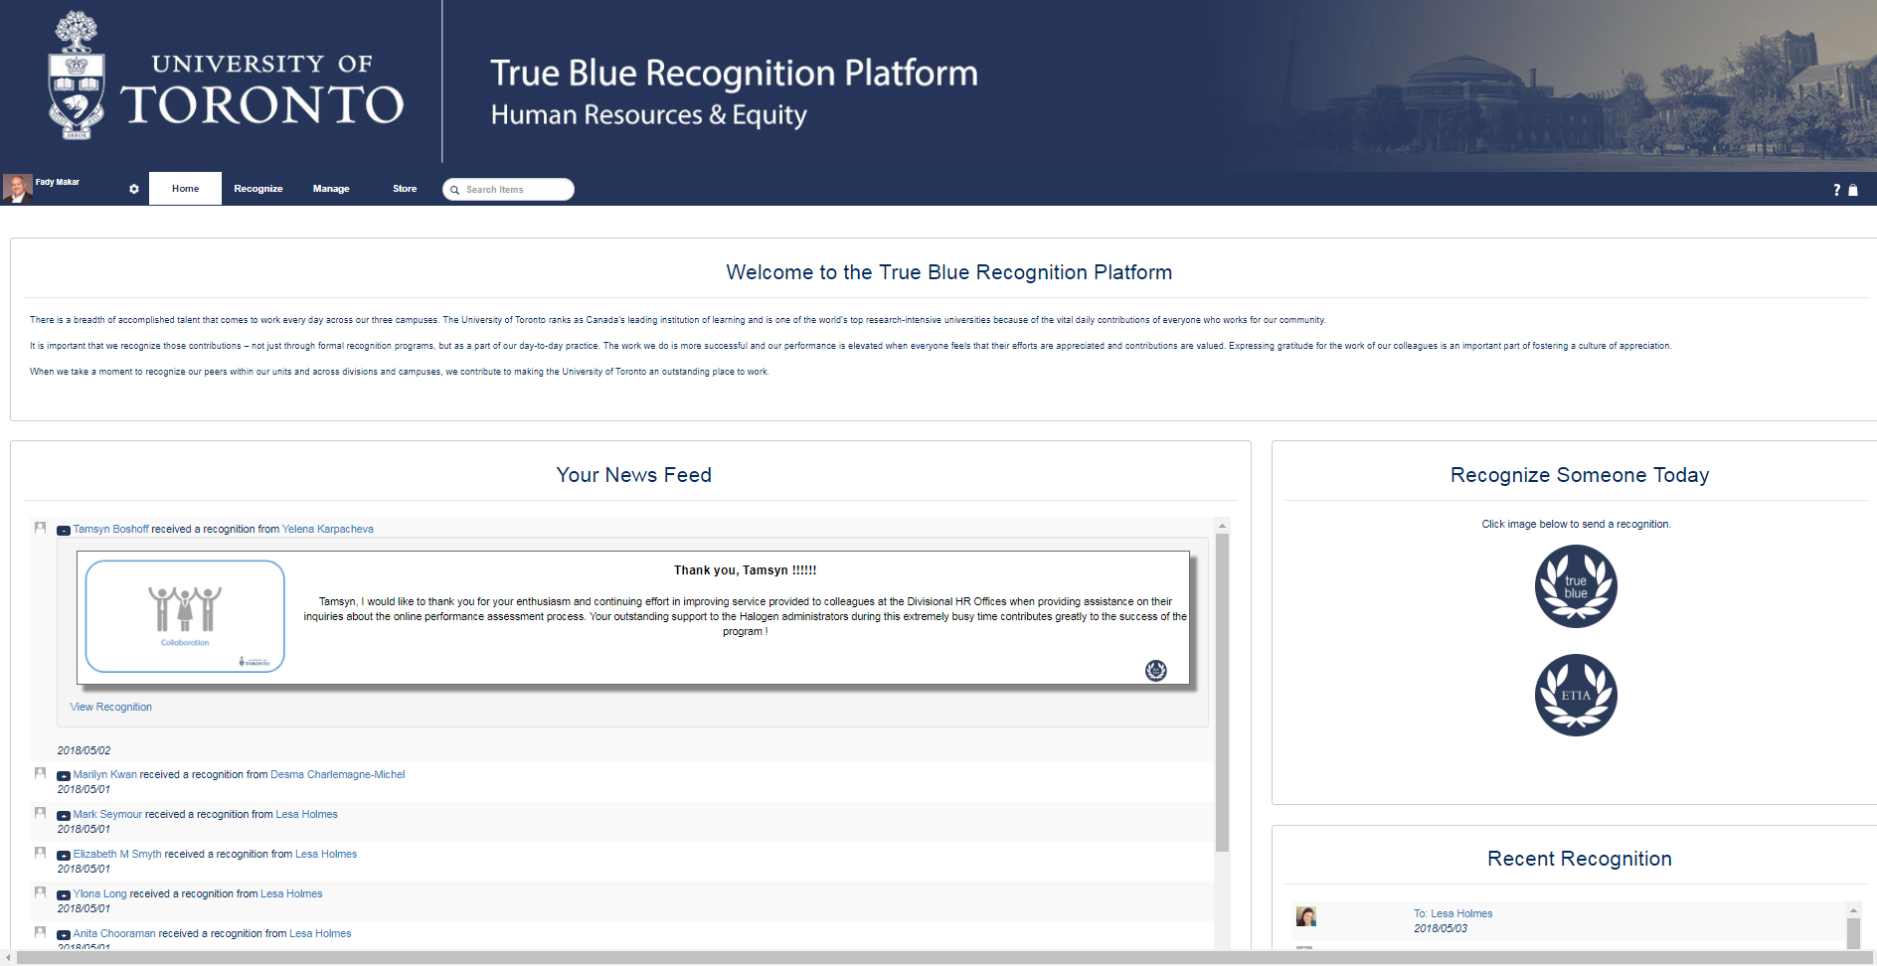
True Blue Recognition Platform
Key Platform Features:
Single sign-on
Mobile responsive page
True Blue Peer to Peer Recognition
Central Staff Award Nominations – ETIA at launch
Divisional Award nominations – onboarding May onwards
Social recognition module – birthdays, milestones, etc.
Monthly Divisional reporting on True Blue Recognitions
Extensive prize redemption catalogue
UofT.me/Thanks
Notes:
Managers want an informal day to day recognition tool
Drie a culture of appreciation by ataking the accountability of recognition waway from our managers and place it on our employees

Slide 9
True Blue – Refresh
True Blue was developed to recognize our unsung heroes. In 2017, 70 employees were recognized with a True Blue award. To build upon the success the impact of the program, we are seeking to transition from an awards only program to a peer to peer recognition model with a monthly award component.
Program Overview:
Peer to Peer Recognition:
All university employees (including staff, faculty and casuals) will have access to send a recognition to a peer for living our institutional values. Recognitions are sent in real time with a carbon copy to the recipient’s manager.
Monthly Awards:
Each month, HR&E will circulate a divisional report of all the recognitions issued through the tool for line of sight.
To celebrate the community’s success we will pick 5-10 nominees to to be featured in The Bulletin and HR&E website as True Blue Award Winners. Winners earn $50 in points to be redeemed through the program catalogue.
Summer Recognition Event:
Each summer all Award Winners and their nominators will be invited to a summer BBQ to recognize their accomplishments and offer them a networking opportunity
Notes:
Managers want an informal day to day recognition tool
Drie a culture of appreciation by ataking the accountability of recognition waway from our managers and place it on our employees

Slide 10
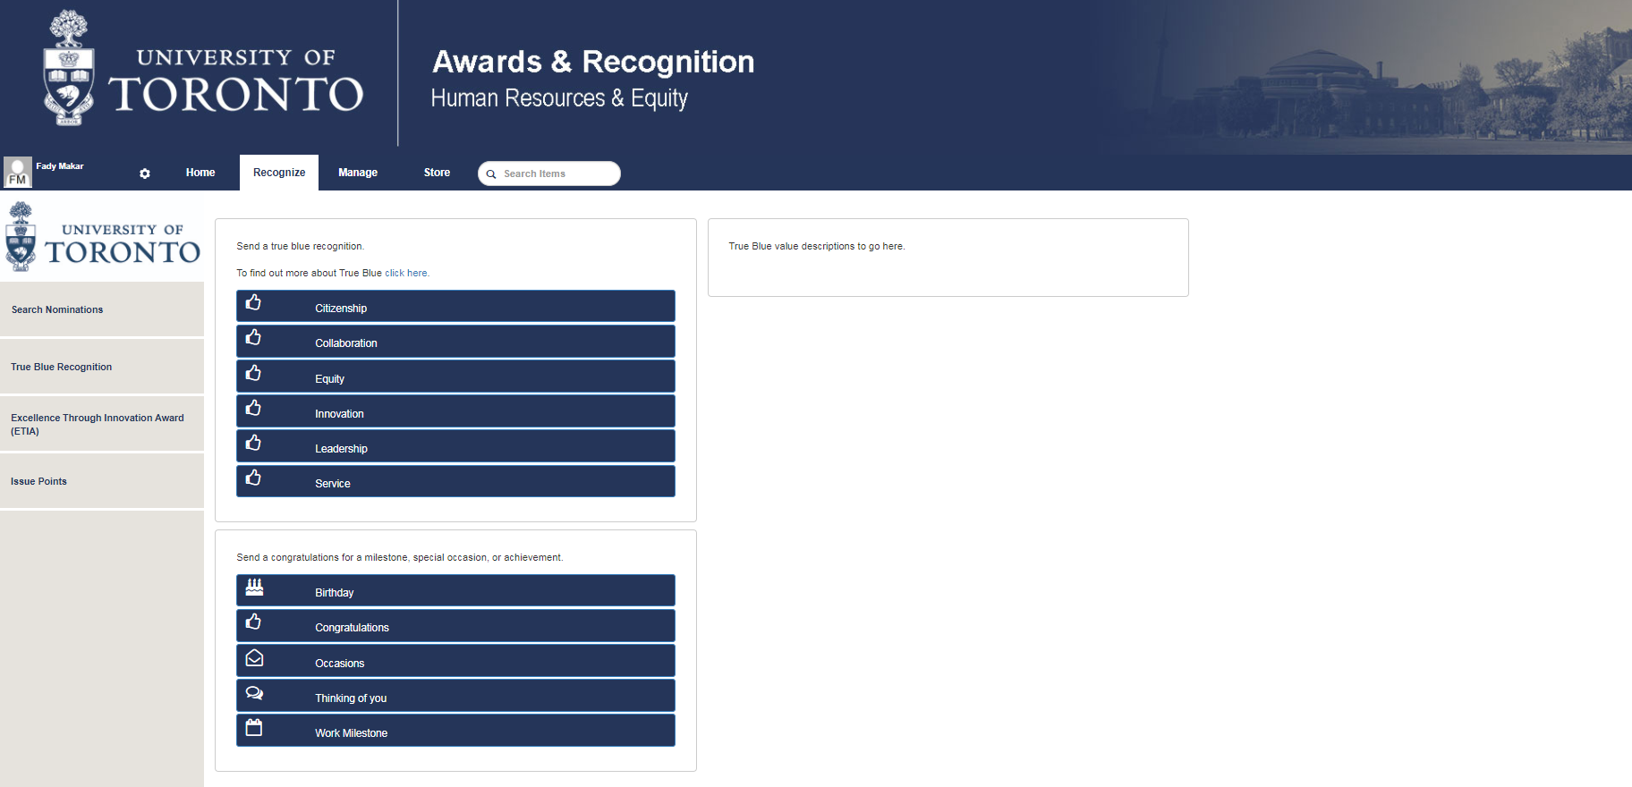
True Blue Recognition Criteria
True Blue Recognition criteria will help us to reinforce behaviours we value at the university. Members of the University Community will select one of the criteria below which most closely aligns to the reason for their recognition
Proposed Recognition Criteria :
Excellence in:
Citizenship
Collaboration
Equity
Innovation
Leadership
Service (internal or external clients)
Notes:
Managers want an informal day to day recognition tool
Drie a culture of appreciation by ataking the accountability of recognition waway from our managers and place it on our employees

Slide 11
Next Steps
Timelines for launching the recognition platform, consulting on the engagement strategy and planning the next Speaking Up Survey
Timelines :
May – December: Launch and sustainment True Blue Recognition Platform
February – September: Consult, build and deploy institutional Engagement Strategy
September – March ‘19: Plan and deploy upcoming Speaking up Survey
Notes:
Managers want an informal day to day recognition tool
Drie a culture of appreciation by ataking the accountability of recognition waway from our managers and place it on our employees

Slide 12

Launching on May 8th send a thoughtful recognition to a peer for a chance to win $50 in points!

